Slide 1
IEEE1149.x JTAG
Boundary Scan Standard
Kiran Kariyannavar

Slide 2
Agenda
Recap
Lab introduction
Inspect Boundary Scan cells
Walk through TAP controller states
Exercise Boundary Scan controller

Slide 3
Recap
Device ID
TAP control
Signals
Tap Controller
Instruction register
Architecture

Slide 4
TAP control signals intent
TCK provides the clock for the test logic
TMS @ rising edge of TCK determines controller state
Serial test instructions/data are received by the test logic at TDI
TDO is the serial output for test instructions/data

Slide 5
JTAG Chip Architecture
Core
A TAP controller (TAPC)
An instruction register
Boundary scan register
A group of test data registers
Bypass register (BR)
Data Register
TDO
TDI
BR
Instruction Register
TAPC
TCK
TMS

Slide 6
TAP Controller
Finite state machine, synchronous w.r.t TCK
Controls sequence of operations
Controls the behavior of the test logic
Maintains synchronization across all test components
  During shifting, capturing, and updating of data

Slide 7
TAP
Controller
State Diagram
1
Test Logic Reset
0
1
Run Test/Idle
1
Select DR-Scan
1
Select IR-Scan
0
0
0
Capture-DR
Capture-IR
1
1
0
0
Shift-DR
0
Shift-IR
0
1
1
Exit1-DR
Exit1-IR
0
1
0
1
0
Pause-DR
0
Pause-IR
1
1
0
Exit2-DR
0
Exit2-IR
1
1
1
Update-DR
Update-IR
0
1
0

Slide 8
Device identification register
Allow part number and version determined through the TAP
Helps identify the correct BSDL and correct test patterns
MSB
31
LSB
0
Version (4) Part Number (16) Manufacturer Identity (11) 1

Slide 9
JTAG Instruction – BYPASS
Core
Data Register
TDO
TDI
BR
Bypass
Instruction Register
TAPC
TCK
TMS

Slide 10
LAB
Schematics
General
Instructions
Exploration
Demo

Slide 11
General objectives
Graphical representation
Possibility to “play” with the training system

Slide 12
Schematics
1. Open the schematic pdf file (Schematic.pdf) and identify instances with boundary scan
2. Why does TDI of instance U1A has pull down and not TDI of instance U2 ?

Slide 13
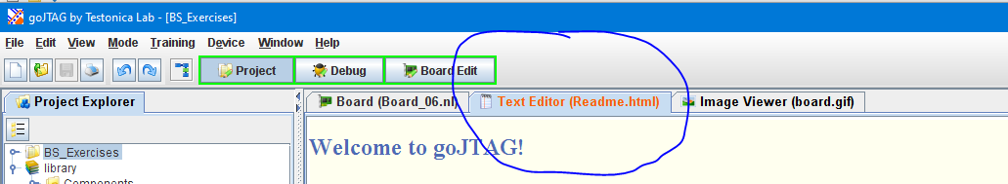
JTAG software
Install sofware with gojtag_v1.2j_Installer.exe
Click “Open example project”
General Readme TAB

Slide 14
Assignment
Open “BS_Exercises” project and select “Board_1.nl” file from Netlists folder
Inspect Boundary Scan cells
Walk through TAP controller states
Exercise Boundary Scan controller
Examine BSD File
Inject faults and observe their effects
Output : Document/Presentation with screenshots/learnings

Slide 15
Questions
List IDCODE of components in Board_1.nl .
How many components are Boundary-Scan complaint in Board_1.nl ?
How many components don’t have Boundary-Scan in Board_1.nl ?
What are the instructions implemented in instance D1 of Board_1.nl ?
What is the minimum number of clock cycles that is enough to return to the Test-Logic-Reset state from any random state when keeping TMS signal high?
Select Board_03. Use EXTEST instruction for BufferOUT and program the values to make all outputs to high Z (make a screenshot of result) ; document the steps.
What is the frequency of TCK in instance BufferIn of Board_03.nl?

Slide 16
Answers
attribute IDCODE_REGISTER of d1: entity is
  "0000" & -- 4-bit version number
  "1101000111010001" & -- 16-bit part number
  "10000000001" & -- 11-bit identity of the manufacturer
  "1";
How many components are Boundary-Scan complaint in Board_1.nl? 3
How many components don’t have Boundary-Scan in Board_1.nl? 1
Instructions implemented in instance D1:
"BYPASS (111)," &
  "EXTEST (000)," &
  "SAMPLE (001)," &
  "CLAMP (010)," &
  "HIGHZ (011)," &
  "IDCODE (100)," &
  "USERCODE (101)„
  minimum number of clock cycles that is enough to return to the Test-Logic-Reset state from any random state when keeping TMS signal high? 5
  Select Board_03. Use EXTEST instruction for BufferOUT and program the values to make all outputs to high Z: <Next slide>
  What is the frequency of TCK in instance BufferIn of Board_03.nl? 20e6

Slide 17


